Slide 1
Distribution of Private Schools
DSC530 - Sophia Weidner

Slide 2
Statistical Question
As a previous high school teacher, who has taught both in private and public schools, I want to see:
How the type of school affects the amount of students and teachers.
How the different types of schools compare to each other, based on location, population, and more.
The data table used for this research analysis is described as: “Table 1. Number and percentage distribution of private schools, students, and full-time equivalent (FTE) teachers, by selected characteristics: United States, 2019–20”

Slide 3
Variables
Private school typology - what type of school we’re examining; Catholic, Nonsectarian, etc…
And then breakdowns within those categories - for example, Catholic is split into parochial, diocesan, etc.
School Level - Elementary/Middle, Secondary/High School, Combined/Other
Size of School - how many students are in each school
Region - which region in the U.S. each school is located in.
Urbanicity type - what type of area the school is located in (city, suburban, town, rural)
All of these specific variables will be measured in percent or total number of Schools, Teachers, and Students.

Slide 4
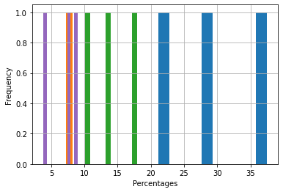
Private School Typology Percentages - Histogram

Slide 5
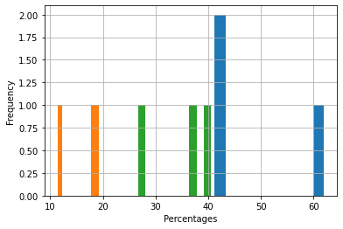
School Level Percentages - Histogram

Slide 6
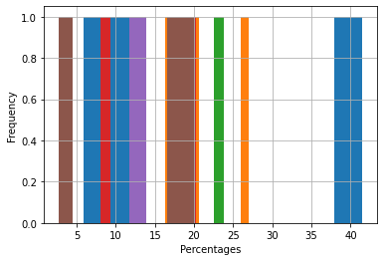
Size of School Percentages

Slide 7
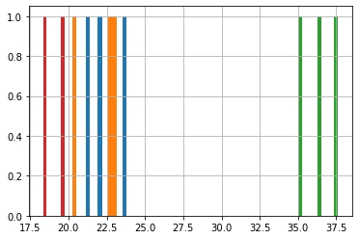
Region Percentages

Slide 8
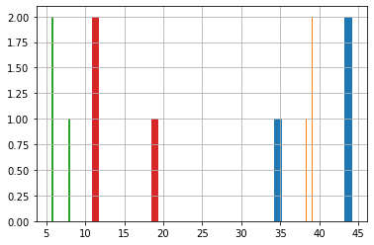
Urbanicity Type Percentages

Slide 9
Histograms: Analysis
In my histograms, I decided to compare each variable in each category; for example, the Private school typology has different bars for each type of school, like Catholic, Diocesan, etc. I went through and did this for each category.
When I originally tried to do the histograms for this dataset, I had outliers in each graph due to the “Totals” being a row rather than a column. So, every time I graphed, I had a 100% in the set that was throwing off the values. Rather than remove the row altogether, I decided to transpose my dataset for easier graphing ability. However, to avoid running into issues in the future, I am going to remove the Total column.

Slide 10
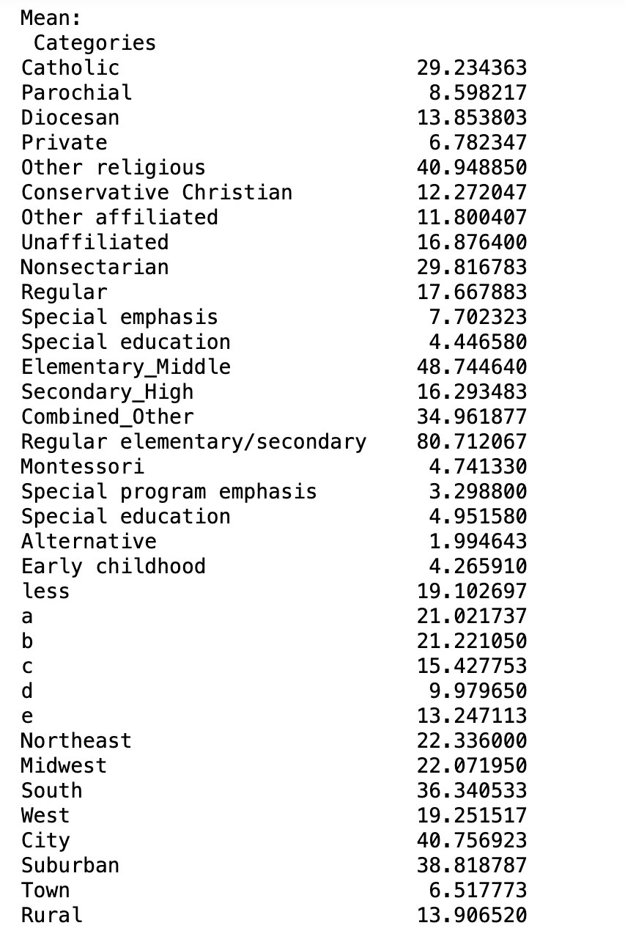
Means (per Category)

Slide 11
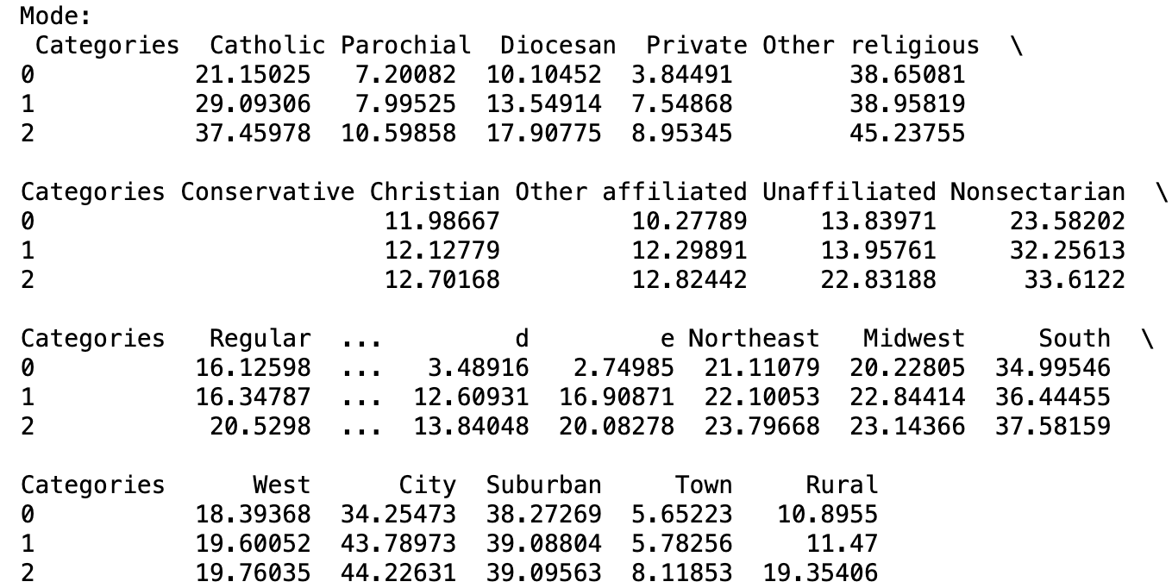
Mode (per Category)

Slide 12
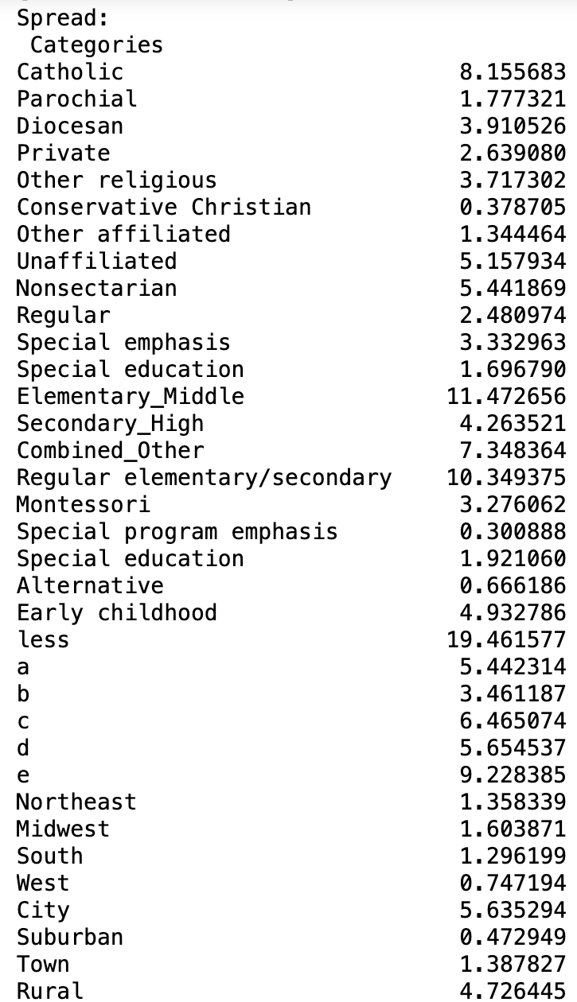
Spread (per Category)

Slide 13
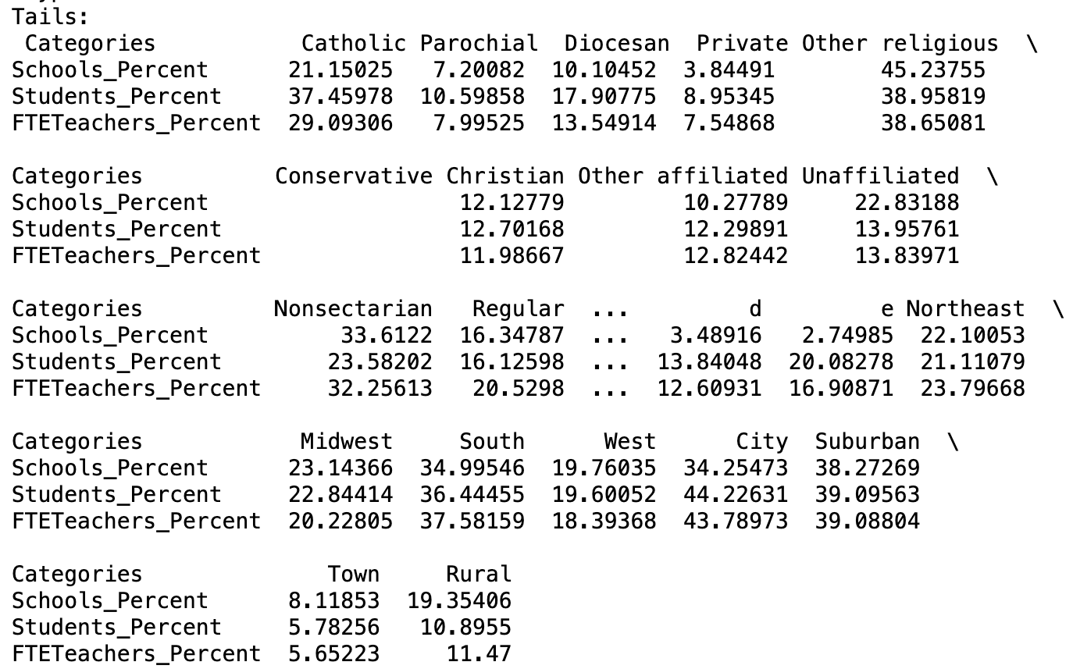
Tails (per Category)

Slide 14
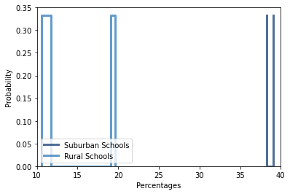
PMF for Rural Schools and Suburban Schools

Slide 15
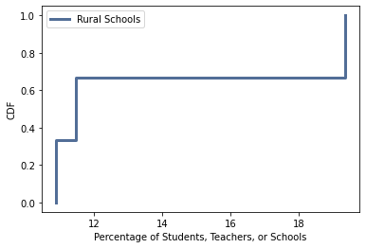
CDF of Rural Schools
According to this CDF, the chance that the percentage of students, teachers or schools is 12% falls within the 70% percentile.

Slide 16
CDF Analysis
The CDF tells me that my dataset is small. It’s difficult to utilize CDF when the data set that I am working with is working in percentages. If I went back to my original data set and filtered it to the amount of teachers, students, etc. as opposed to the percentage, it would be more useful.
When looking at the ‘Rural’ subset of my data, I have 3 data points: Percent of Rural Schools (19.35%), Percent of Students in Rural Schools (10.89%), and Percent of Teachers in Rural Schools (11.47%).

Slide 17
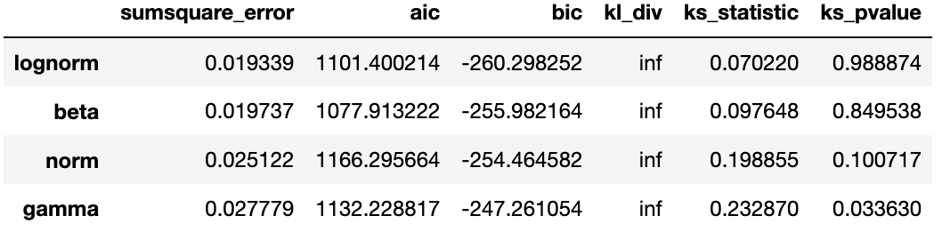
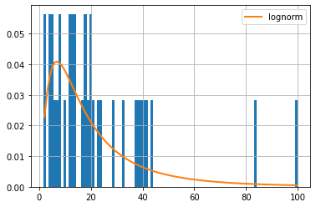
Distribution Analysis
I ended up reverting back to my original data set (before it was transposed) to look at the data through a different lens. The first thing I did was plot the histogram through the parameter “FTETeachers_Percent” which shows the percentage of teachers in each criteria. After using a Fitted function, it was determined that the best distribution for this dataset was the lognorm distribution. This simply means that the logarithms of the percentages of teachers present as normal on a graph. This makes sense because percentages and logarithms are inverses, and the histogram of the data appears normal but slightly skewed. I assume that if I were to do this with the other percentages, like percentages of students or schools, it would yield similar results.

Slide 18
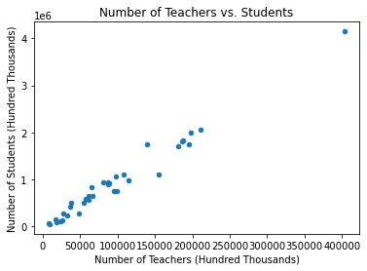
Scatter Plot 1: Number of Teachers vs. Students
The data has a strong, positive, linear relationship. When running the correlation test between number of Students and Teachers, the coefficient reads positive and close to 1 (.99 in Pearson R) in all three tests. I believe that as a school gets more students, you will need more teachers; and this scatterplot is solid evidence for that. It may not be the sole cause, however, For example, more students means more schools that need to be built, which also means more teachers for new schools. There can always be an underlying factor.

Slide 19
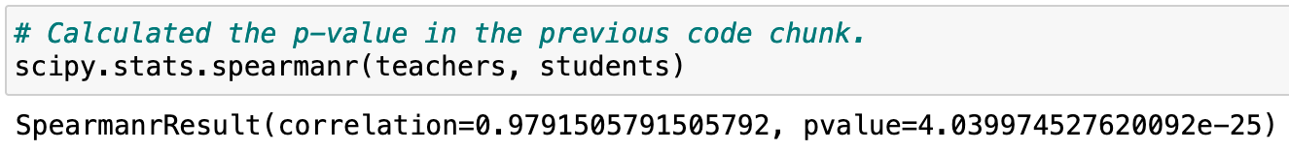
Hypothesis Test: Number of Teachers compared to Number of Students
When conducting the Spearman hypothesis test between the number of teachers compared to the number of students, the p-value comes out to be practically zero. This means that the effect we have seen when comparing amount of students to teachers is statistically significant. If we were to look at comparable data sets, they would more than likely have a similar pattern.

Slide 20
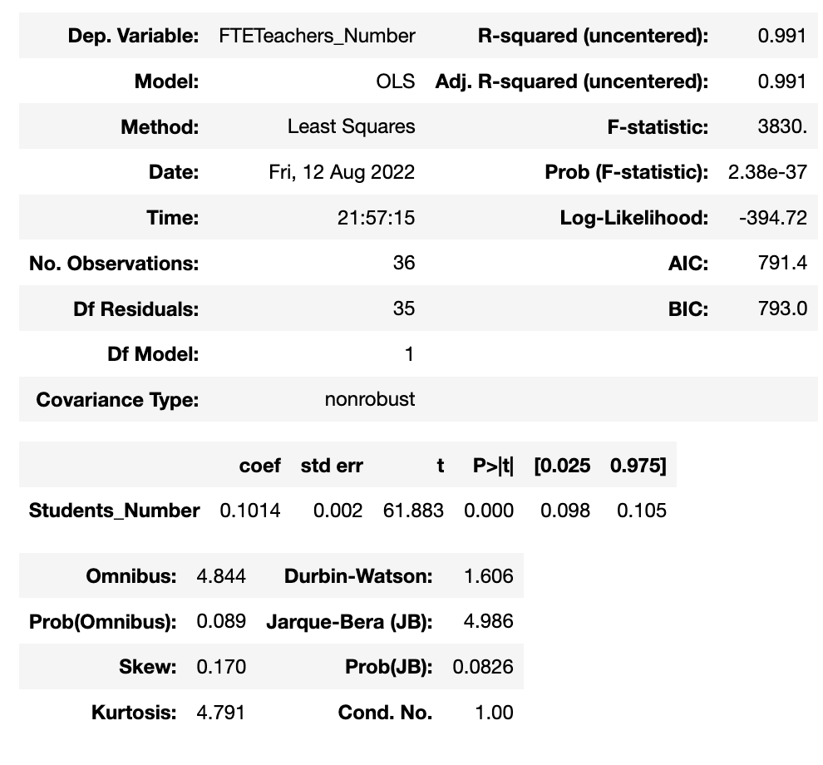
Regression Analysis

Slide 21
Summary

